Slide 1
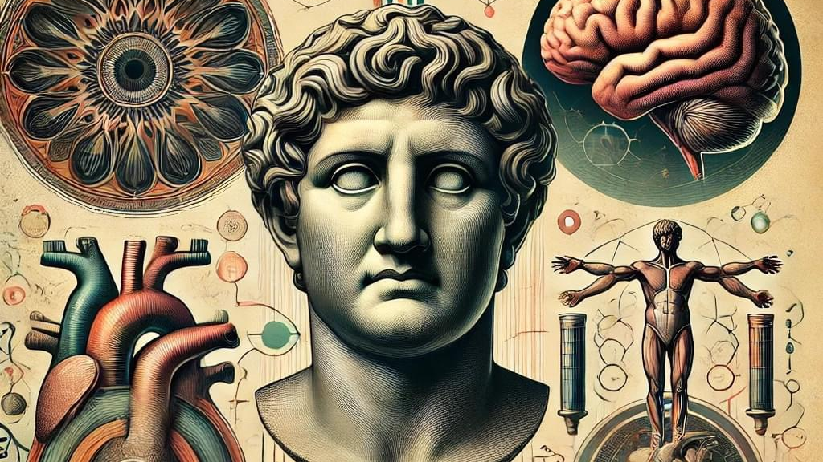

Slide 2


Slide 3
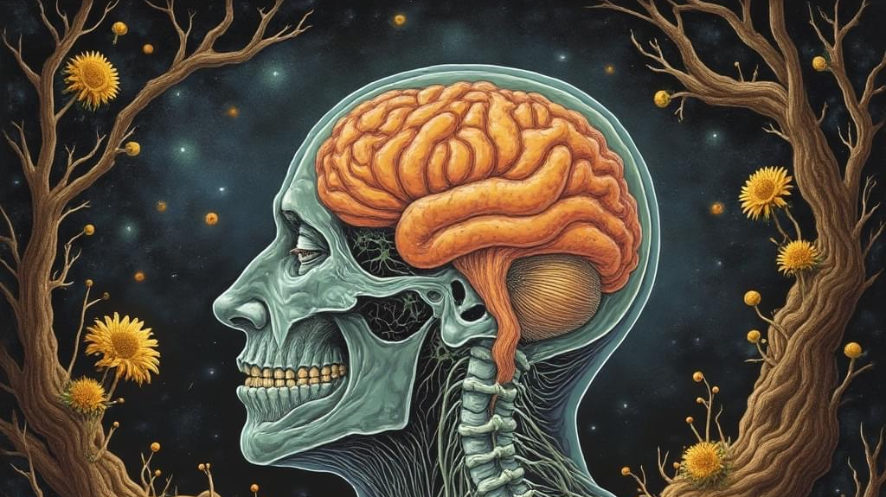

Slide 4
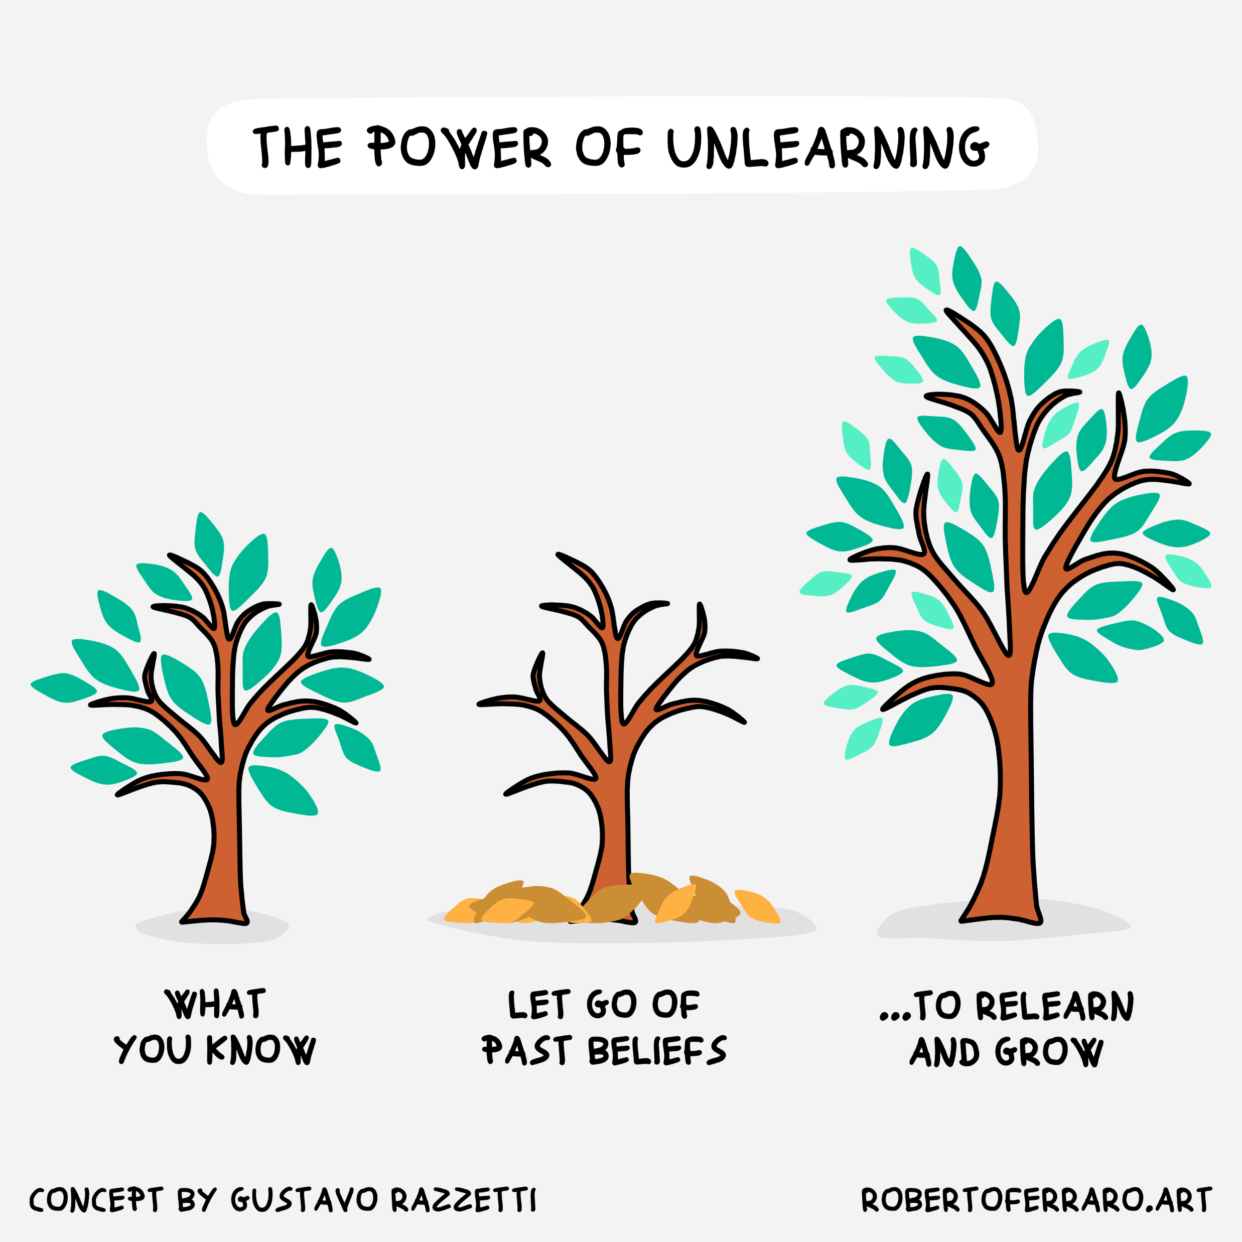

Slide 5
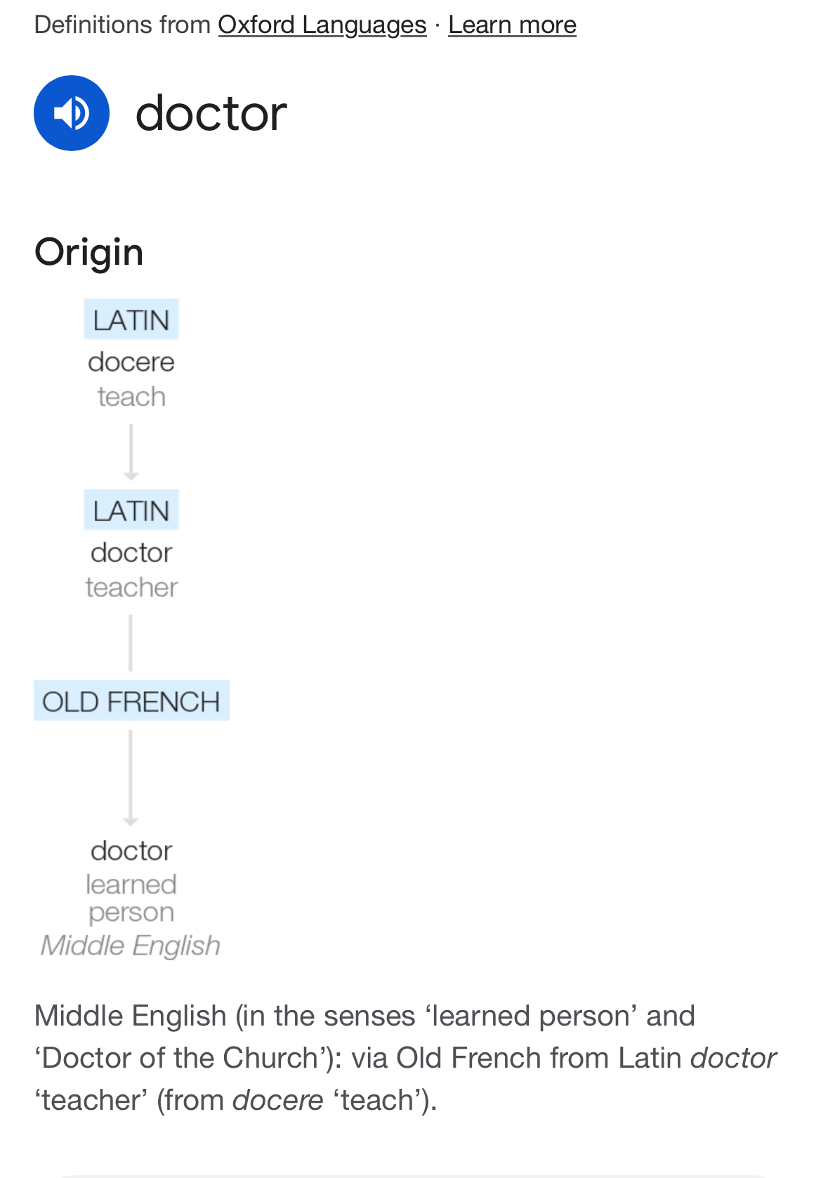

Slide 6
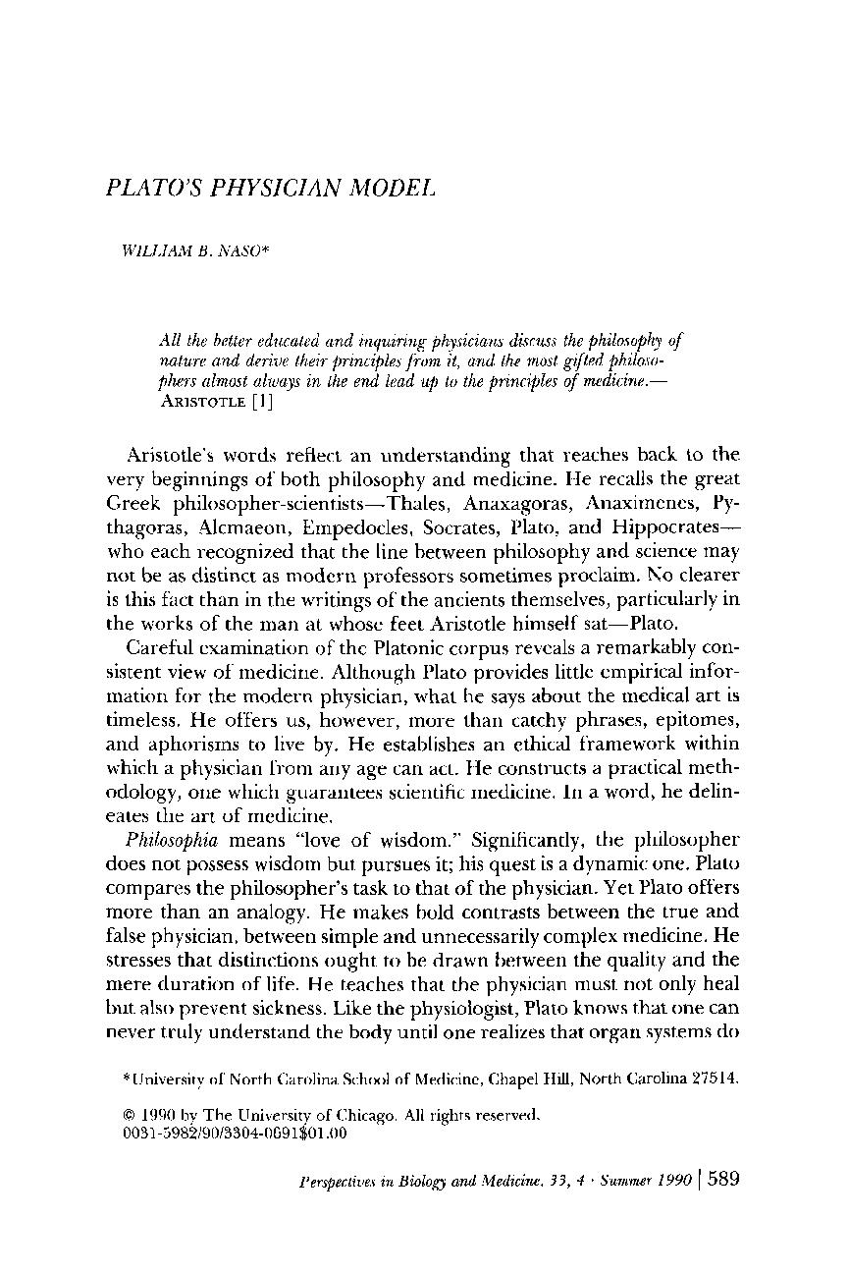

Slide 7

What is Life?
What is Health?
What is Healthy Life?

Slide 8

Does our Education system teach us?
Does our Healthcare institution heal us?
Does our Society prepare us?

Slide 9
Does our Education system teach;
-Critical thinking
-Dietary nourishment
-Emotional regulation
-Relationship expectations
-Finance management
-Societal behaviour
-Risk stratification
-Task prioritisation
-Civilisation sense
-Cosmic alignment

Slide 10
Is it HealthCare or SickCare?
Is our Doctors/HCP healthy?
Can Drs diagnose & treat broken HealthCare?
Do Drs discuss Nutrition, Exercise, LifeStyle etc?
Do we need Reactive Doctors or ProActive Healers?

Slide 11
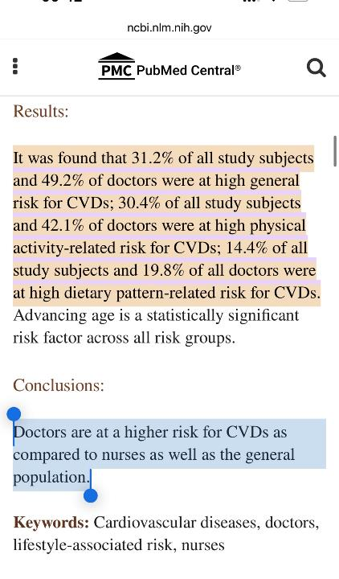

Slide 12
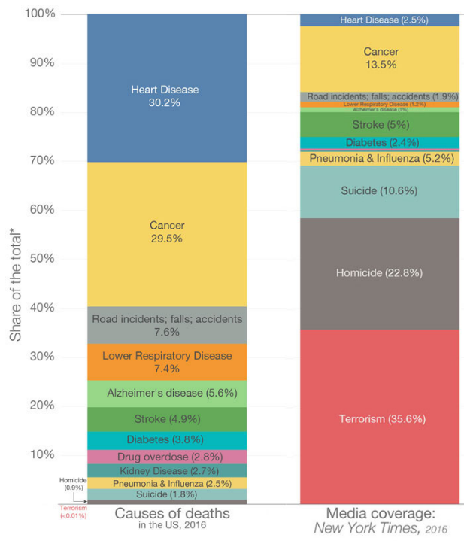

Slide 13
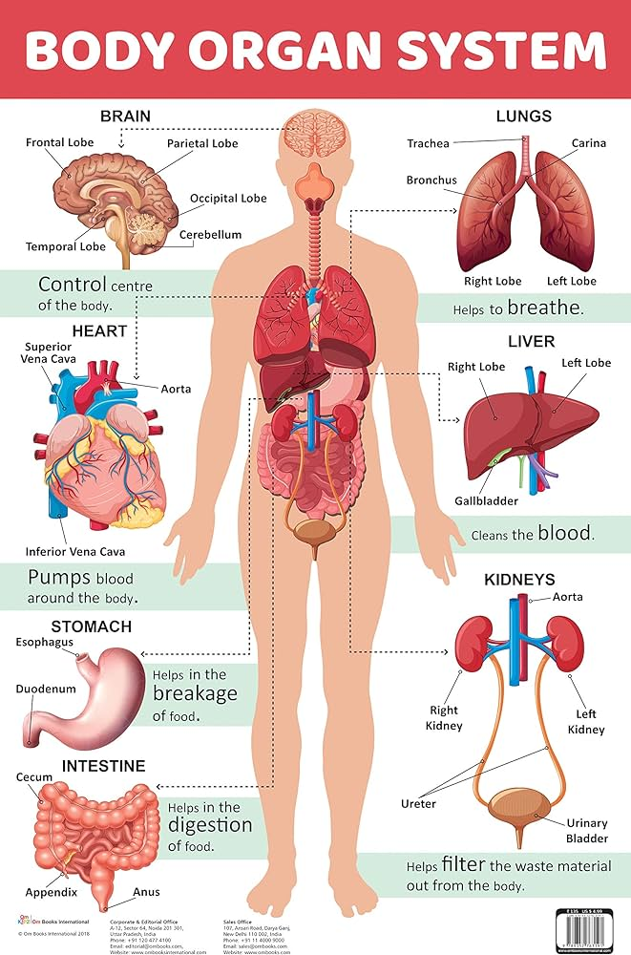

Slide 14
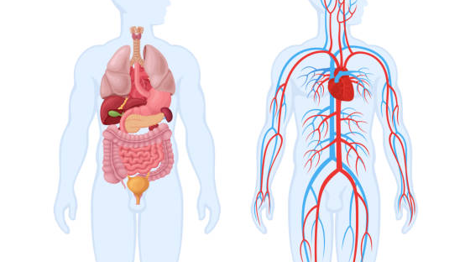

Slide 15
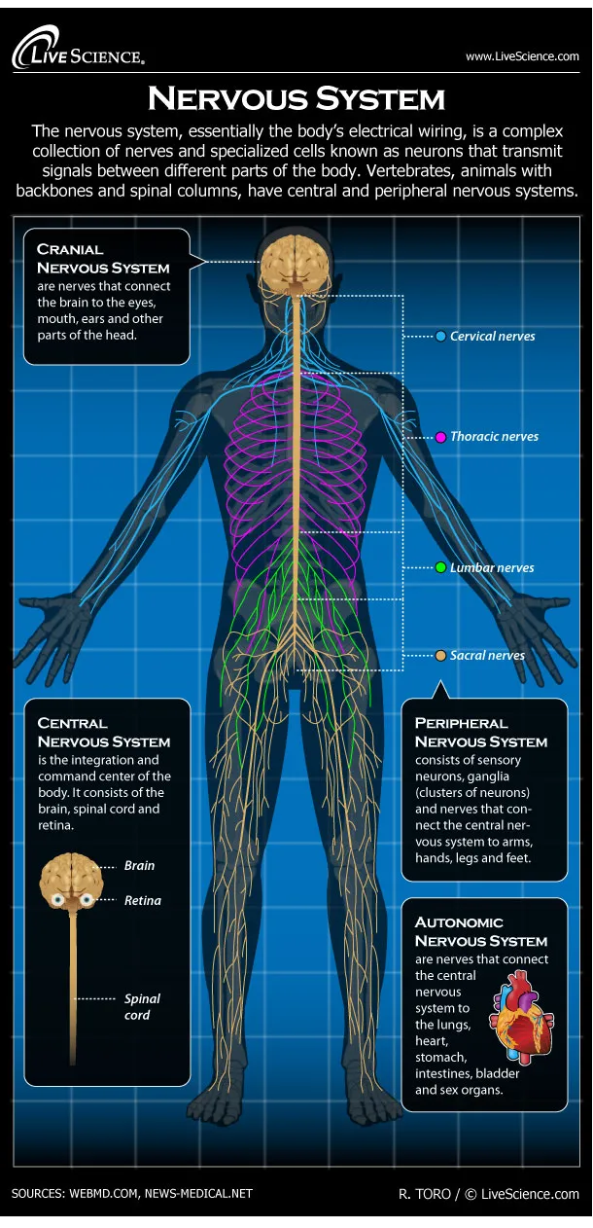

Slide 16
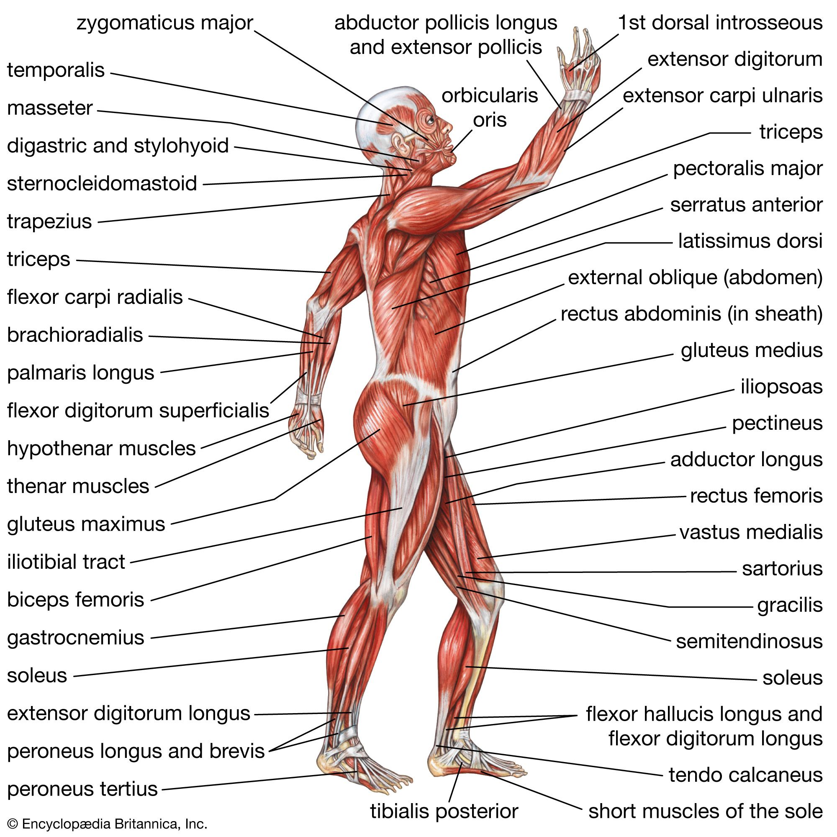

Slide 17
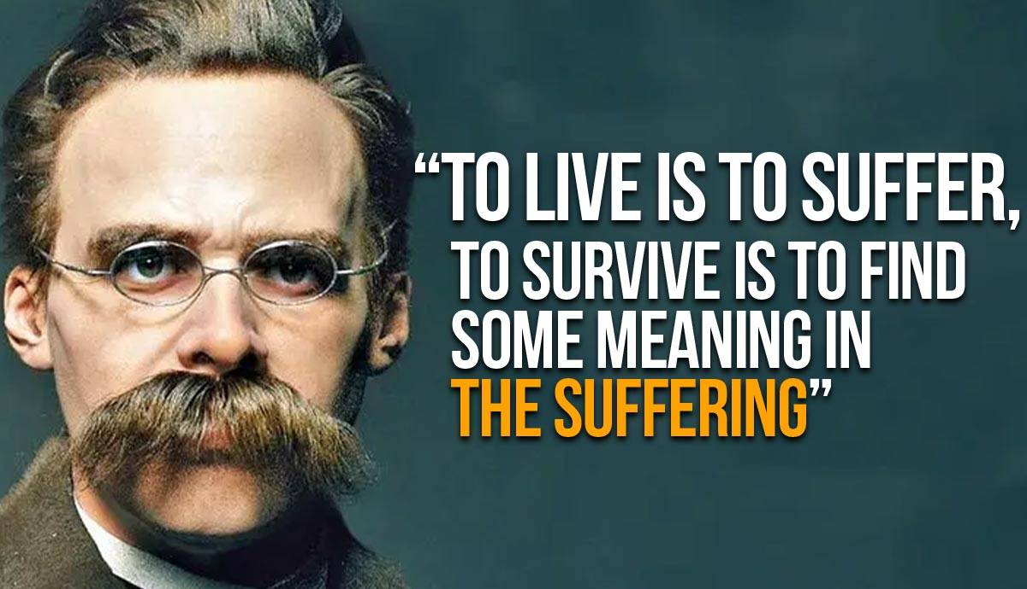

Slide 18
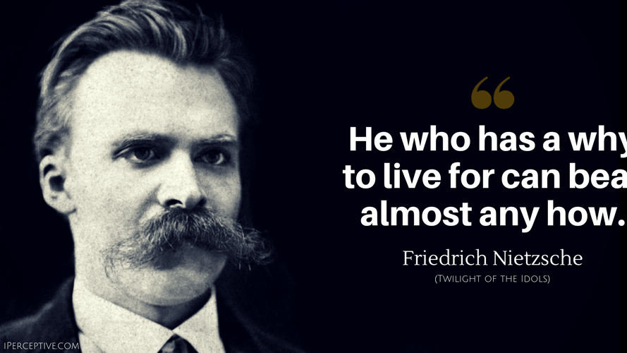

Slide 19
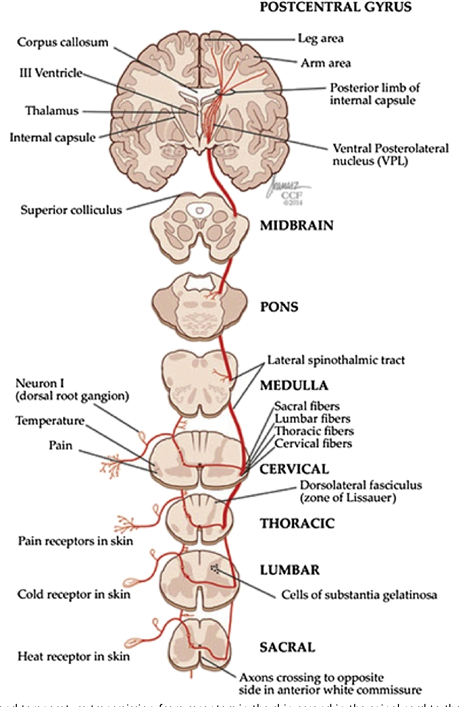

Slide 20
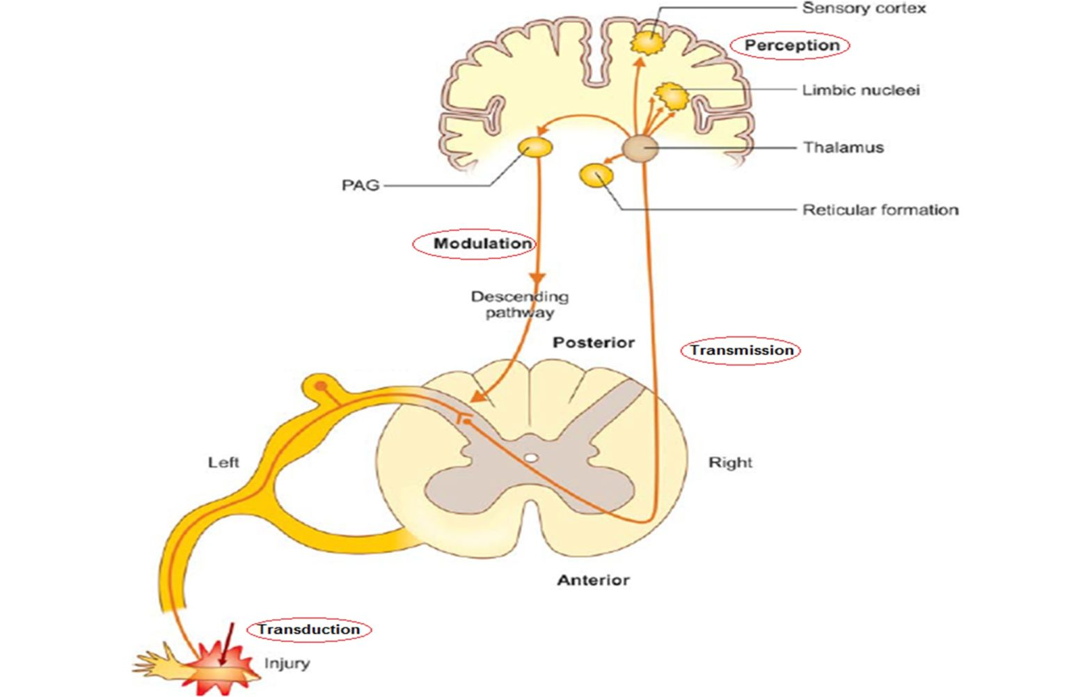

Slide 21
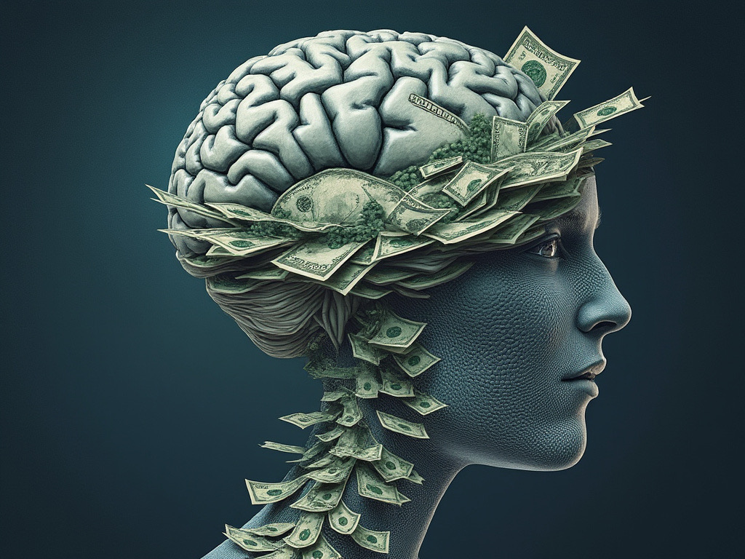

Slide 22
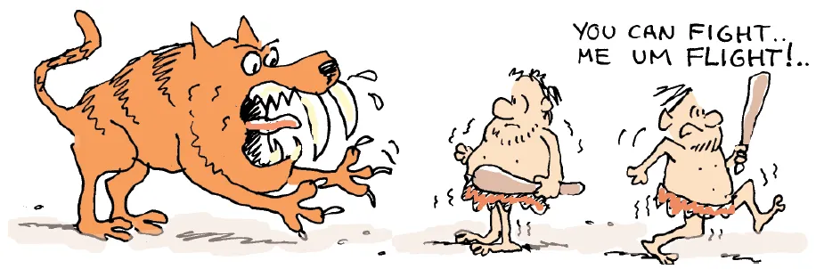

Slide 23
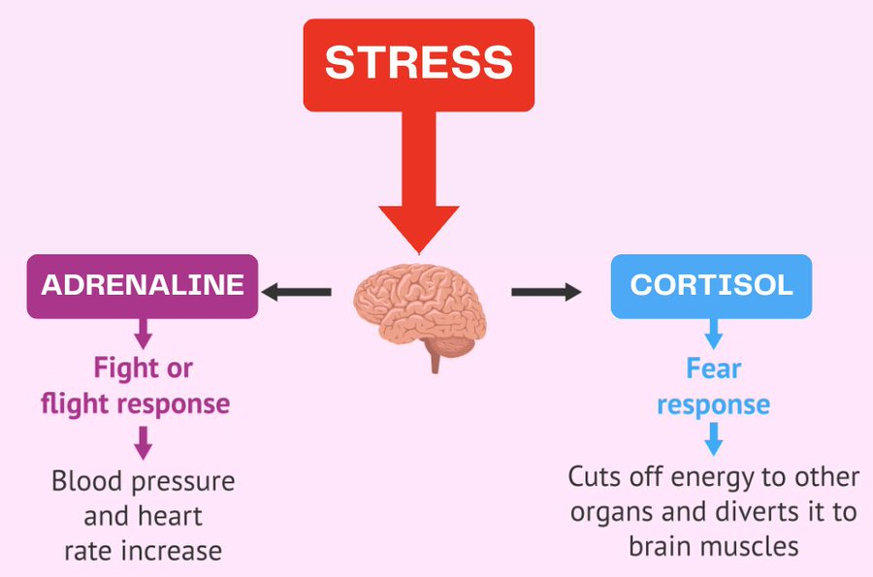

Slide 24
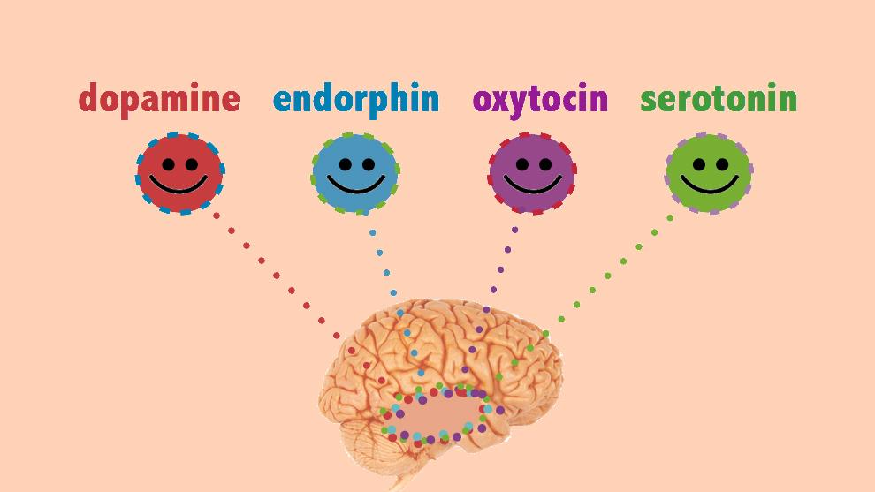

Slide 25
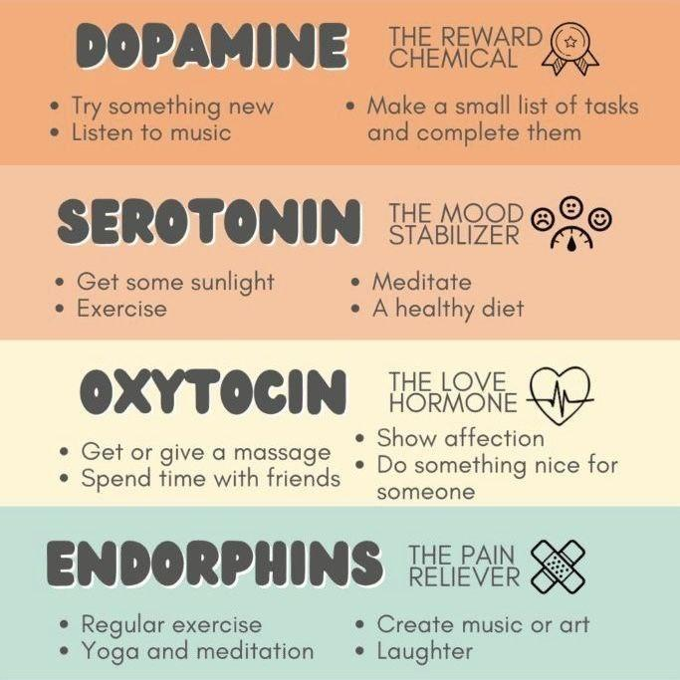

Slide 26
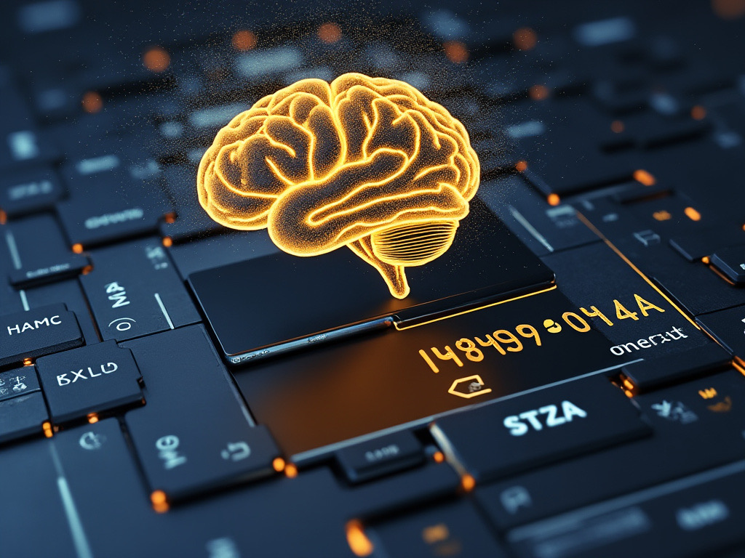

Slide 27


Slide 28
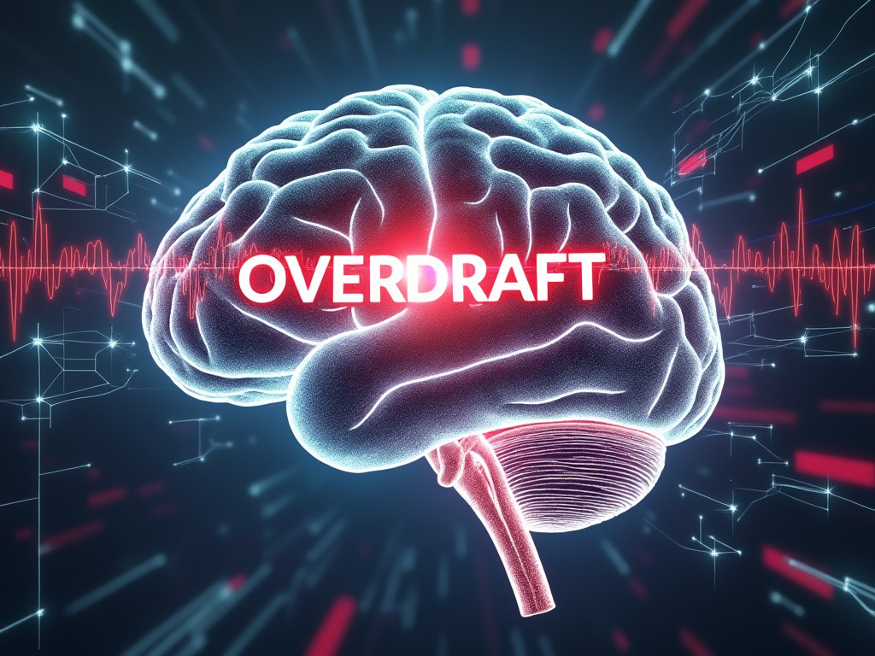

Slide 29
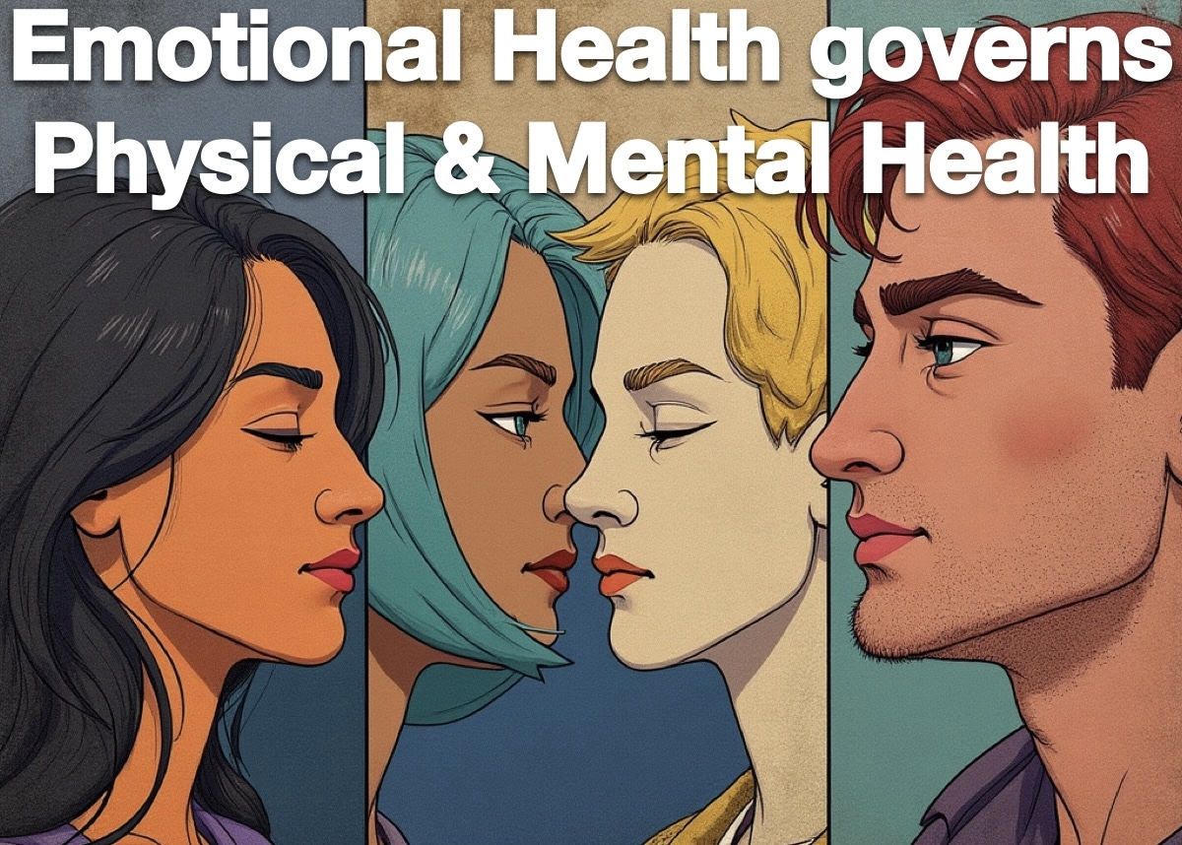

Slide 30
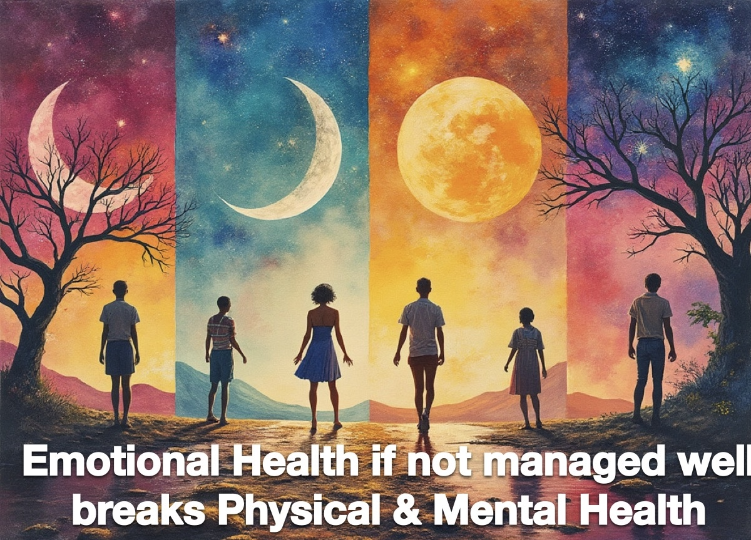

Slide 31
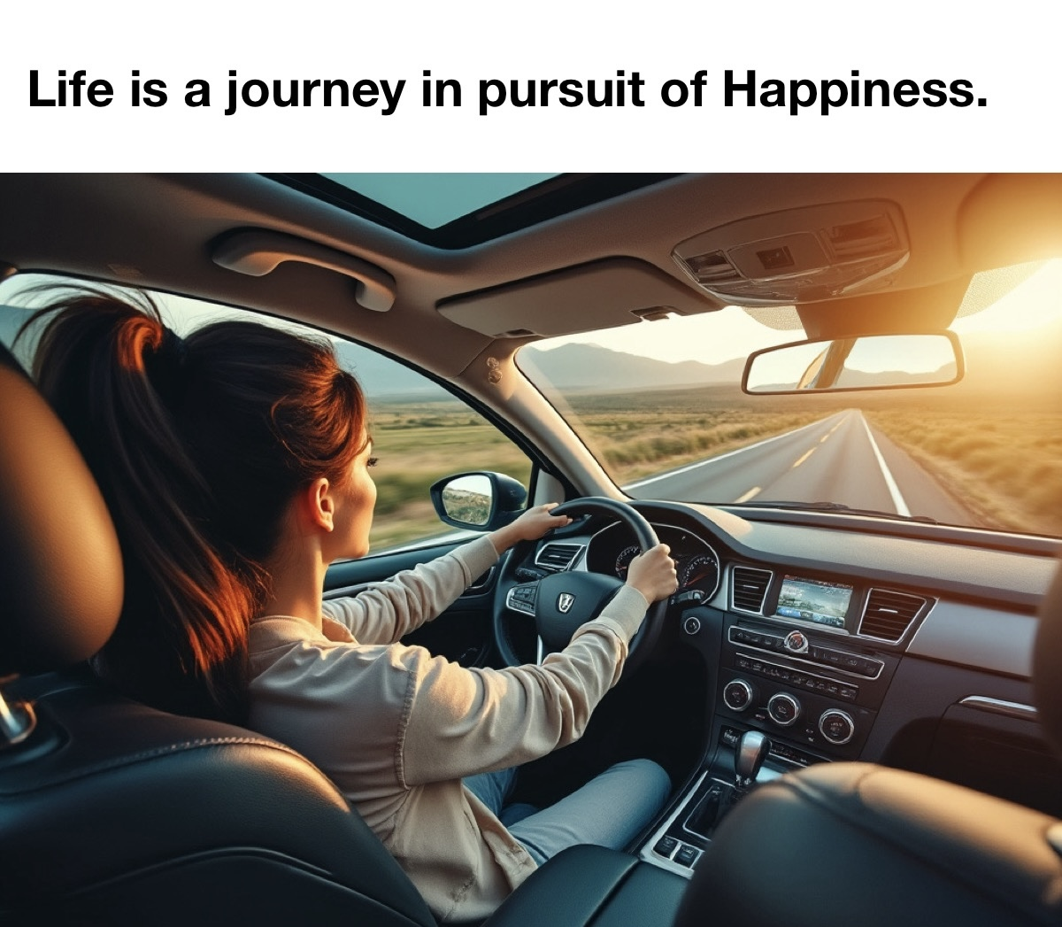

Slide 32
What is Life?
Life is a journey in pursuit of happiness.
Life is also a journey on the unchartered terrain where every driver creates own path while no one has map either. We grow up, create an imagination filled map calling illusion as perfection.
Perfection is just a dynamic figment of an imagination by juvenile mind lost in fantasy land chasing a life that doesn’t exist adding burden on our own self.

Slide 33
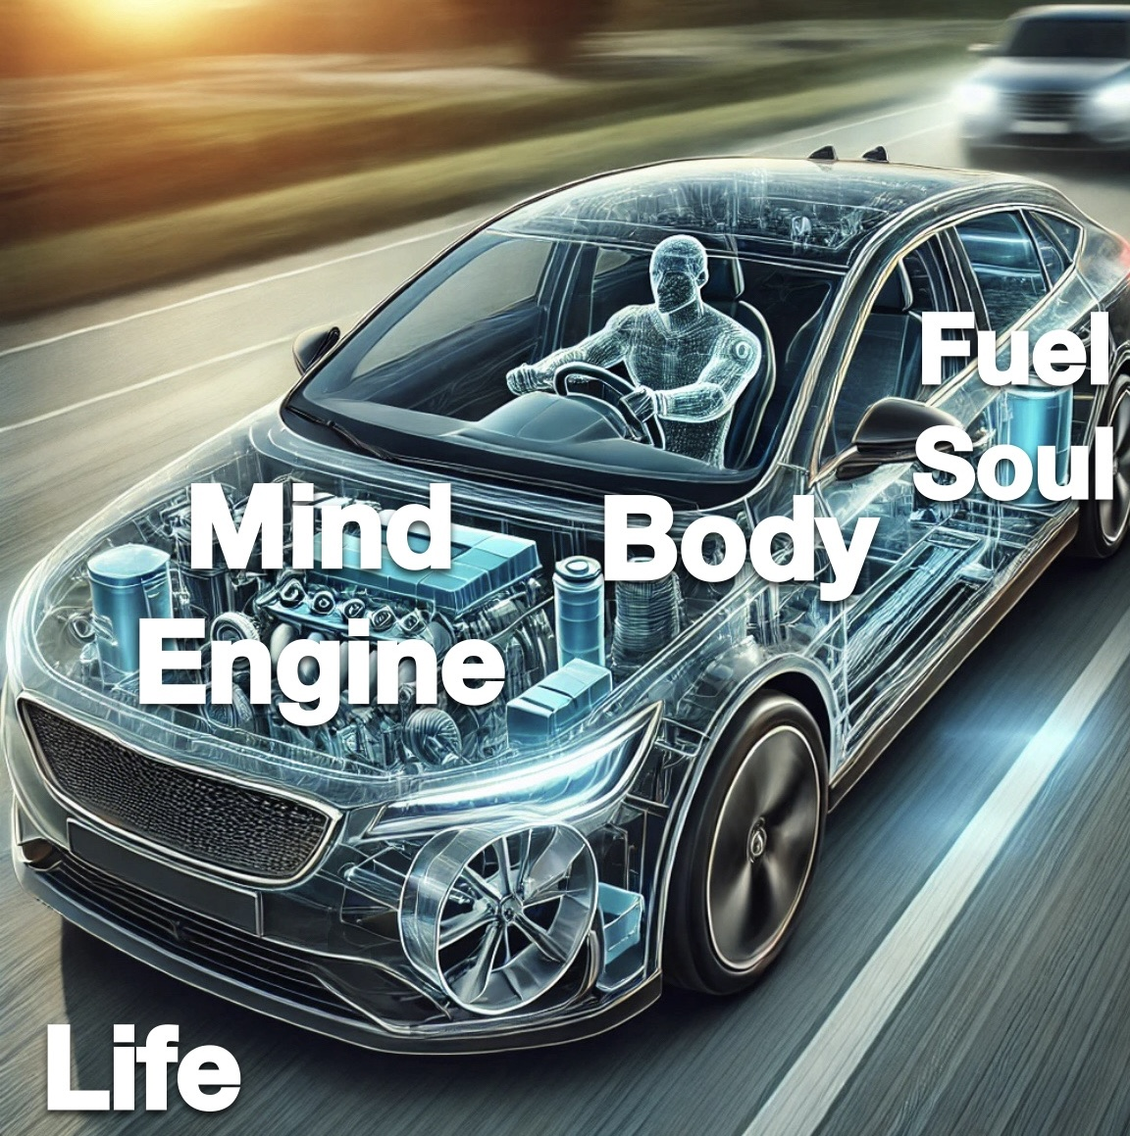

Slide 34
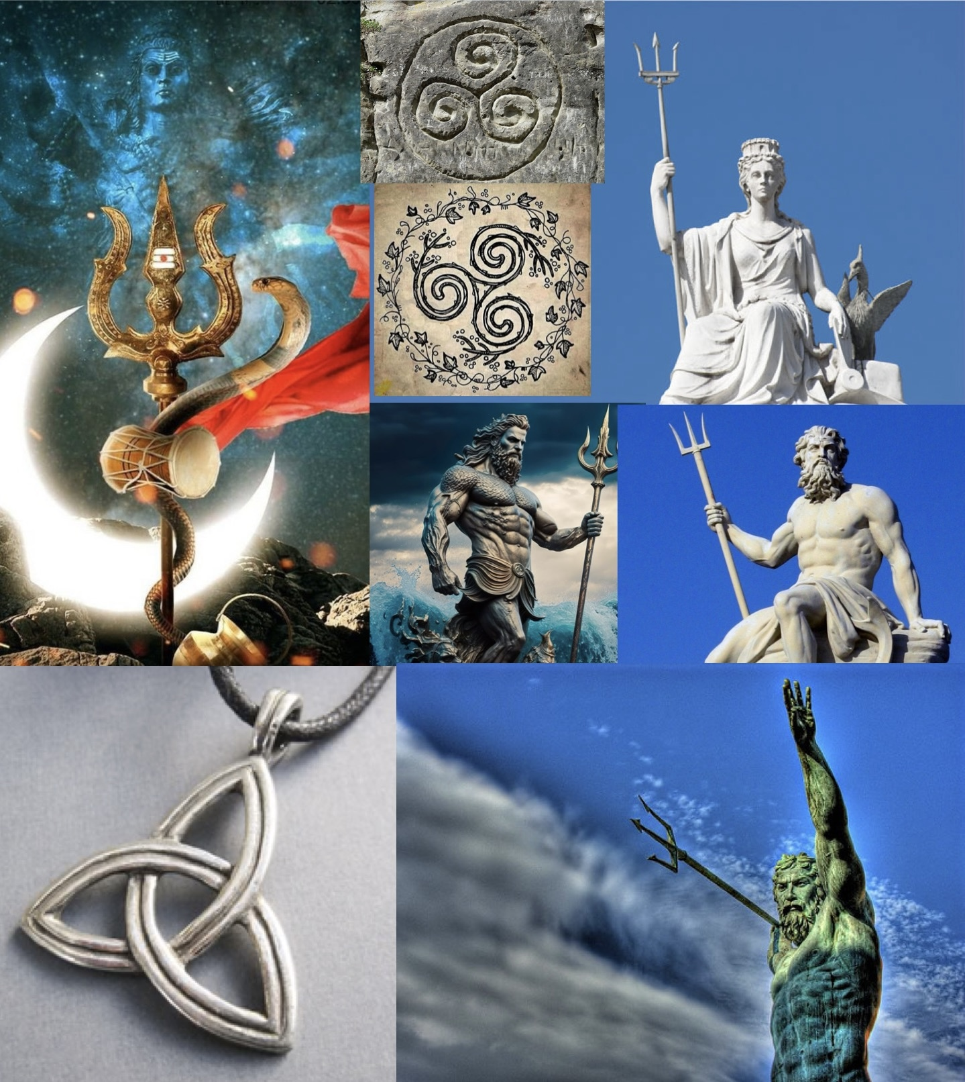

Slide 35
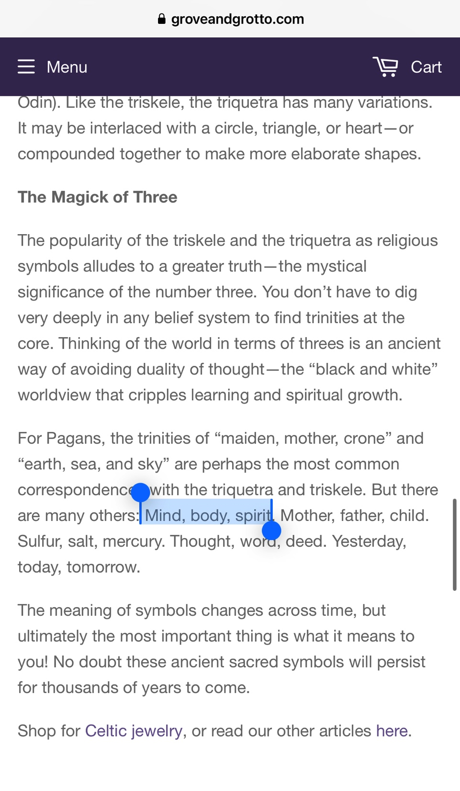

Slide 36
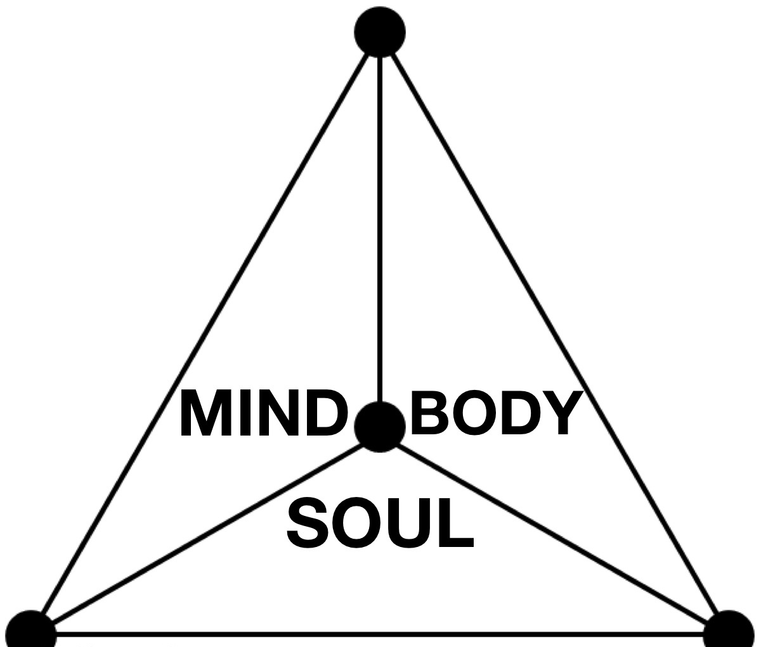
TRIANGLE of HEALING

Slide 37
Mind
Happiness VS Contentment
What defines Happiness & are you?
Why not & how to?
Self-care VS Self-centric

Slide 38
Body
Diet & Nutrition
Vitamins(D) & Minerals
Fitness & Exercise
Breathing coordination
Sleep, Rest & Recovery

Slide 39
Soul
Contentment
Purpose of Life
Right, Wrong or Righteous
Soul is window to Cosmos

Slide 40
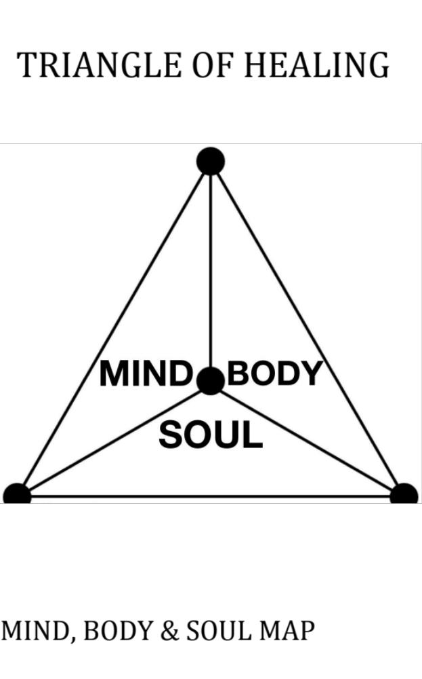

Slide 41
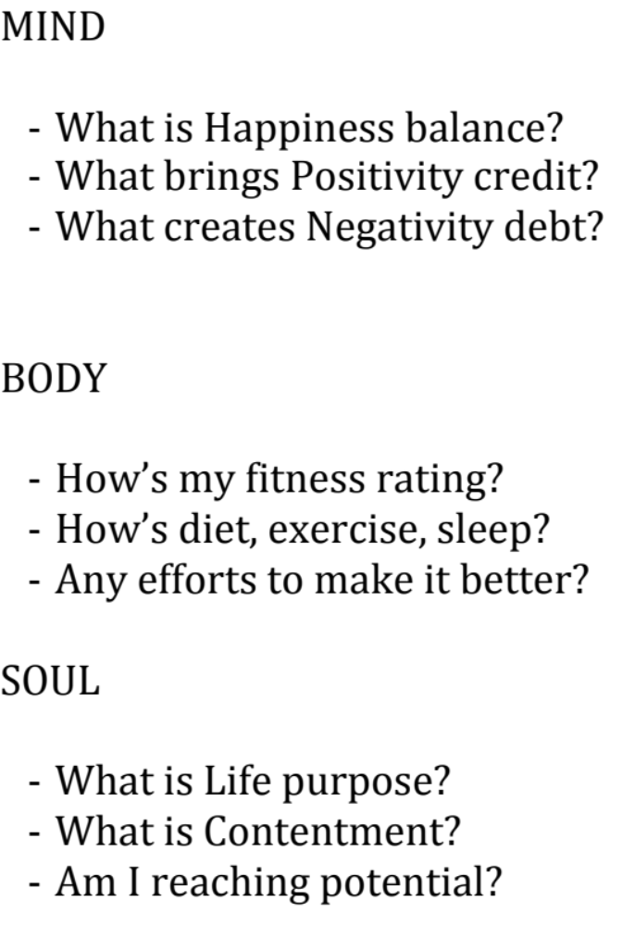

Slide 42
