Slide 1
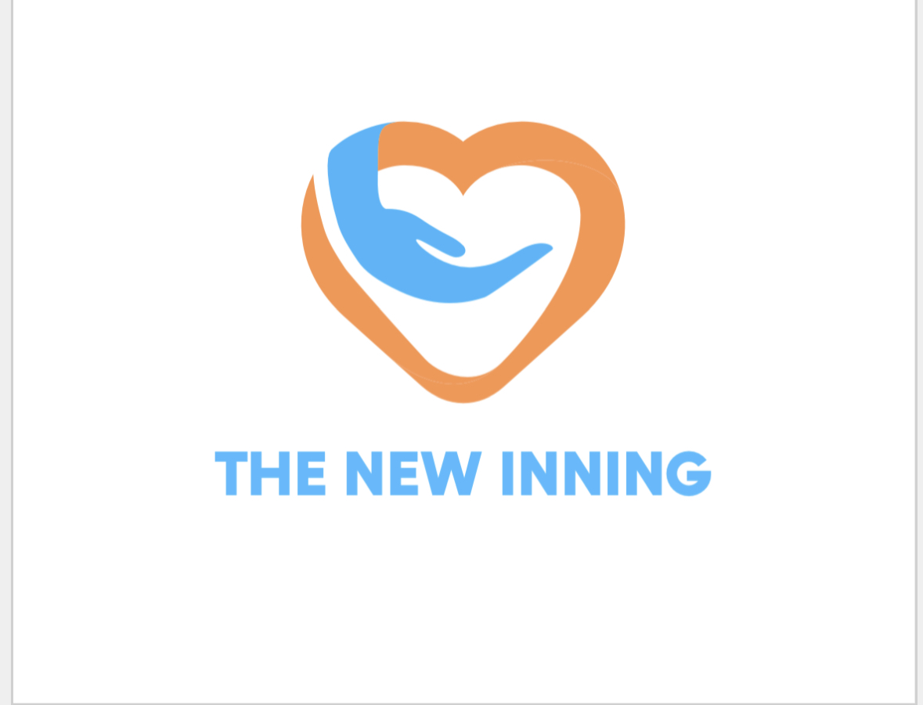
THE NEW INNING
A New Beginning
Welcome to The Holistic Healing

Slide 2
What is Life?
What is Health?
What is Healthy Life?

Slide 3
Does our Education system teach us?
Does our Healthcare institution heal us?
Does our Society prepares us?

Slide 4
Does our Education system teach us;
-Critical thinking
-Dietary nourishment
-Emotional regulation
-Relationships expectations
-Finances management
-Societal behaviour
-Risk stratification
-Task prioritisation
-Civilisational sense
-Cosmic alignment

Slide 5
Is it HealthCare or SickCare?
Is our Doctors/HCP healthy?
Can Drs diagnose & treat broken HealthCare?
Do Drs discuss Nutrition, Exercise, LifeStyle?
Does the World needs Doctors or Healers?

Slide 6
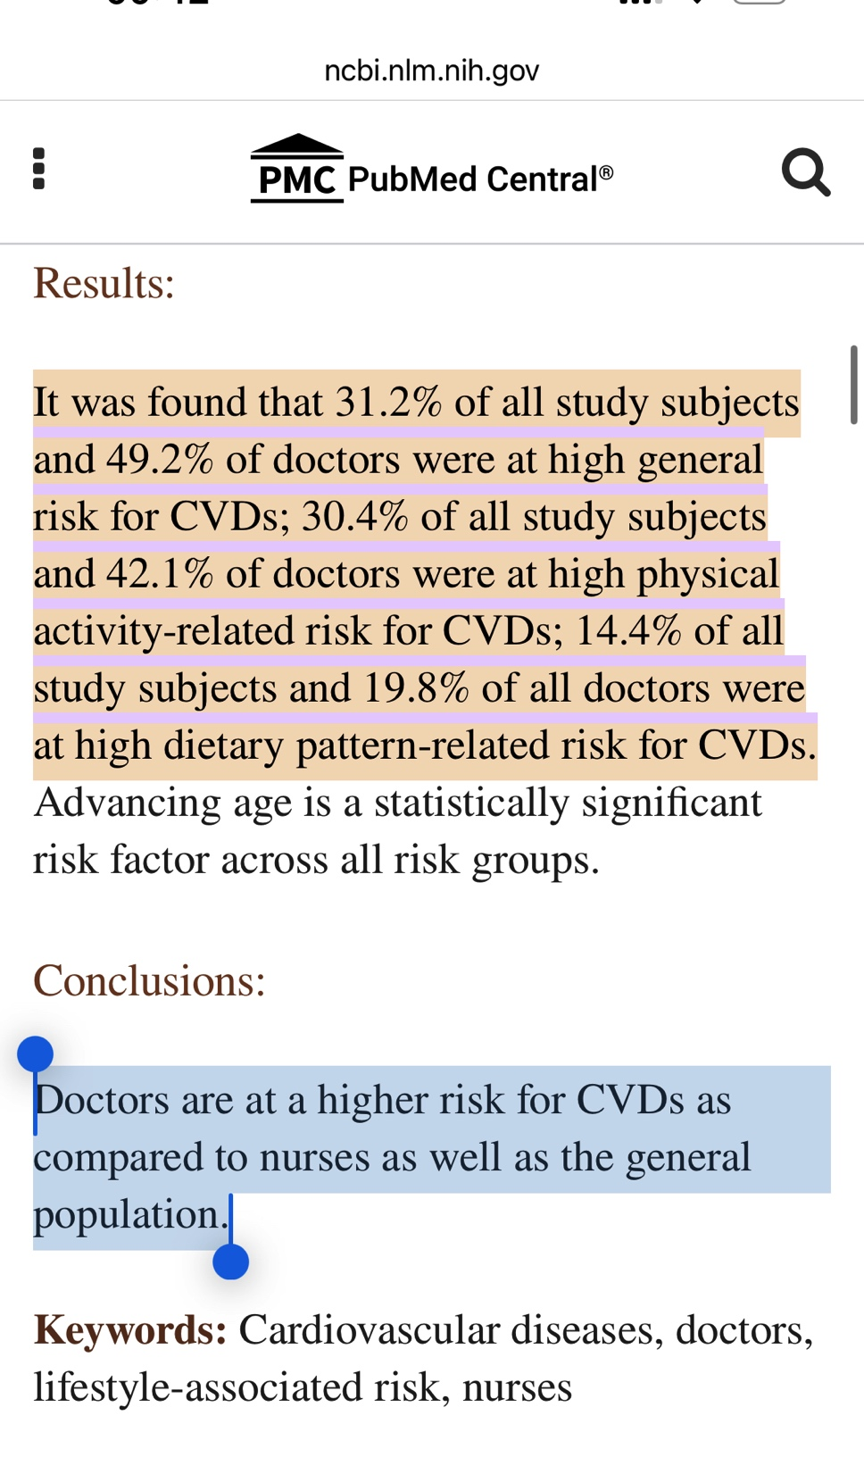

Slide 7
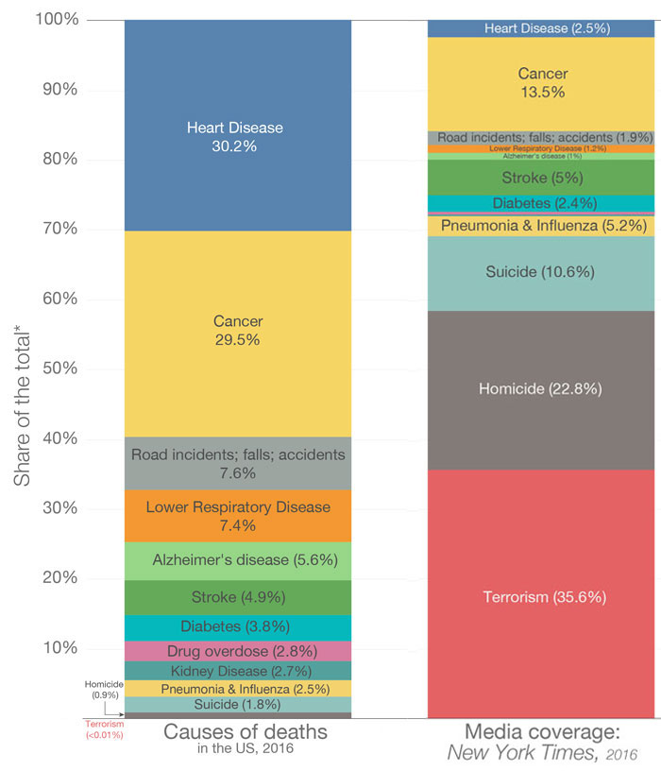

Slide 8
What is Life?
Life is a journey in pursuit of happiness.
Life is also a journey on the unchartered terrain where every driver creates own path while noone has map either. We grow up, create an imagination filled map calling illusion as perfection.
Perfection is just a dynamic figment of an imagination by juvenile mind lost in fantasy land chasing a life that doesn’t exist adding burden on our own self

Slide 9
What is Health?
Health is synapse & synergy of Mind, Body & Soul
Three interconnected domains
TriAngle of Healing

Slide 10
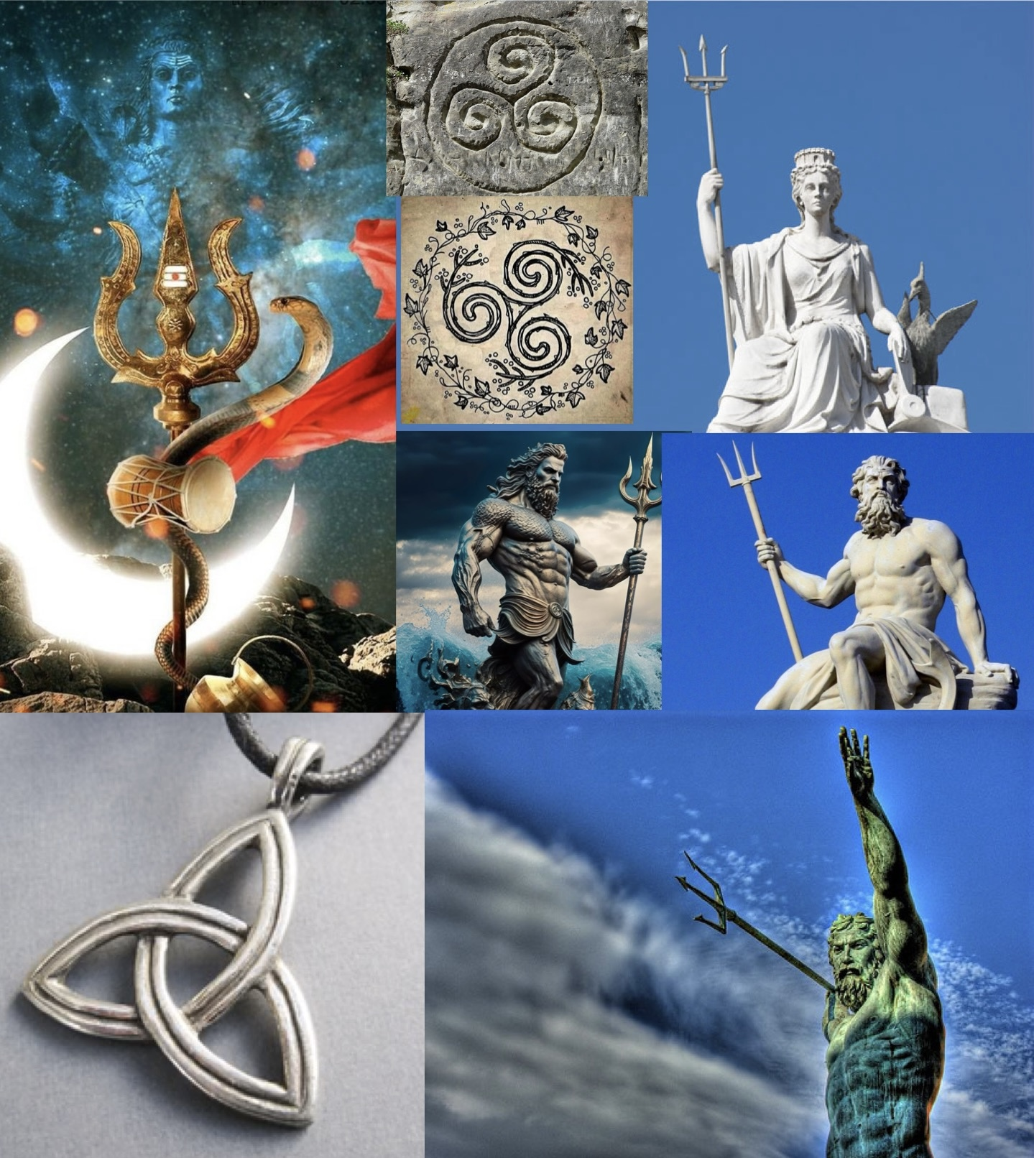

Slide 11
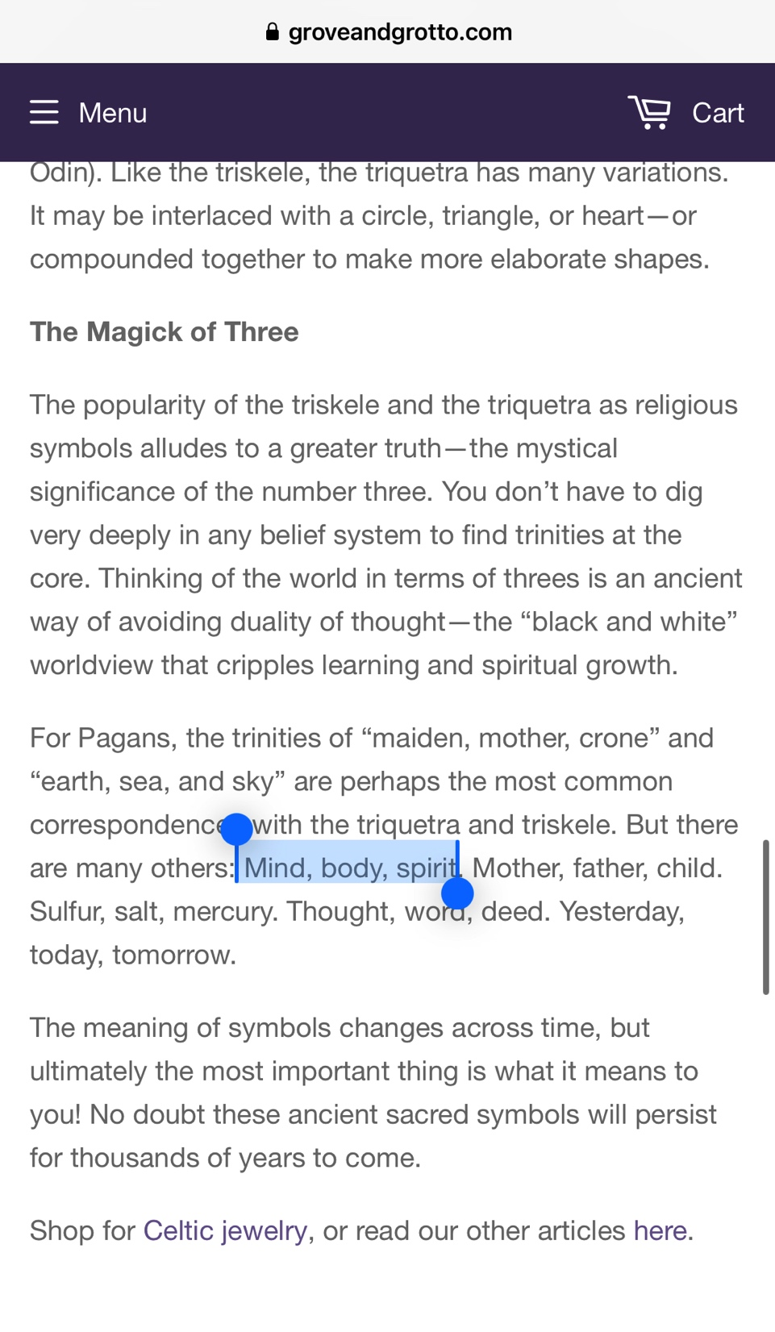

Slide 12
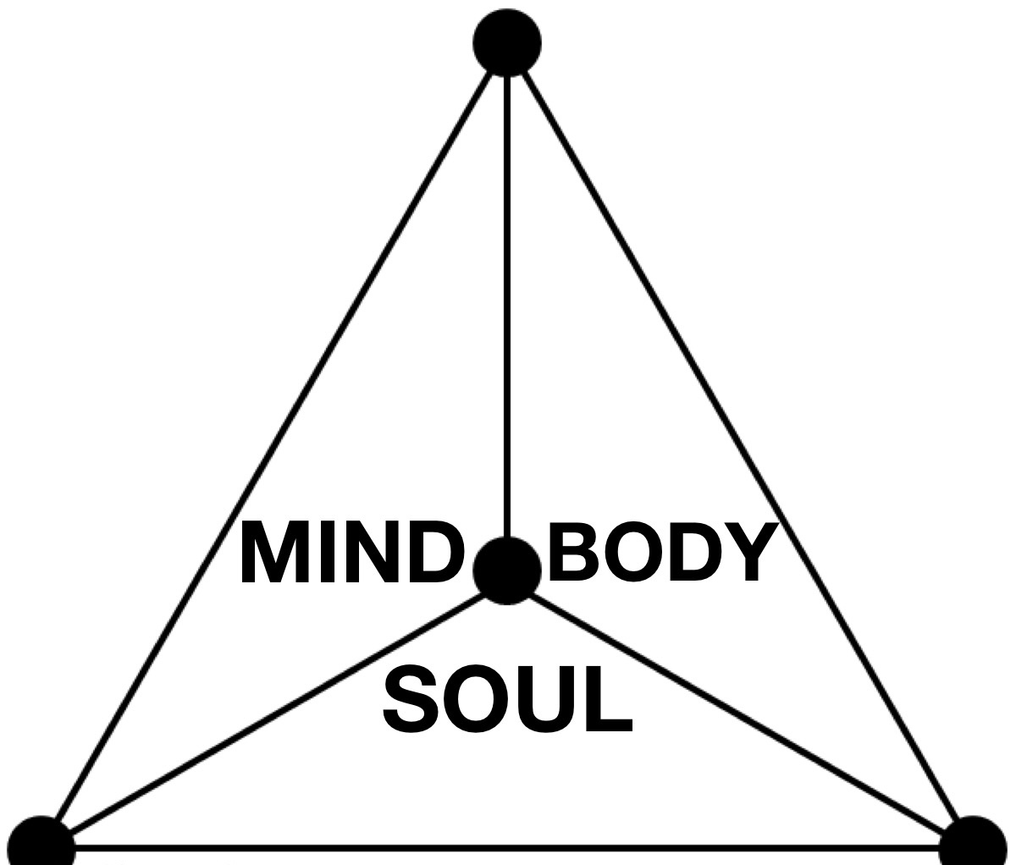
TRIANGLE of HEALING

Slide 13
Mind
Happiness VS Contentment
What defines Happiness & are you?
Why not & how to?
Self-care VS Self-centric

Slide 14
Body
Diet & Nutrition
Vitamins(D) & Minerals
Fitness & Exercise
Breathing coordination
Sleep, Rest & Recovery

Slide 15
Soul
Contentment
Purpose of Life
Right, Wrong or Righteous
Soul is window to Cosmos connected by neural net as multi UniVerses in MultiVerse

Slide 16
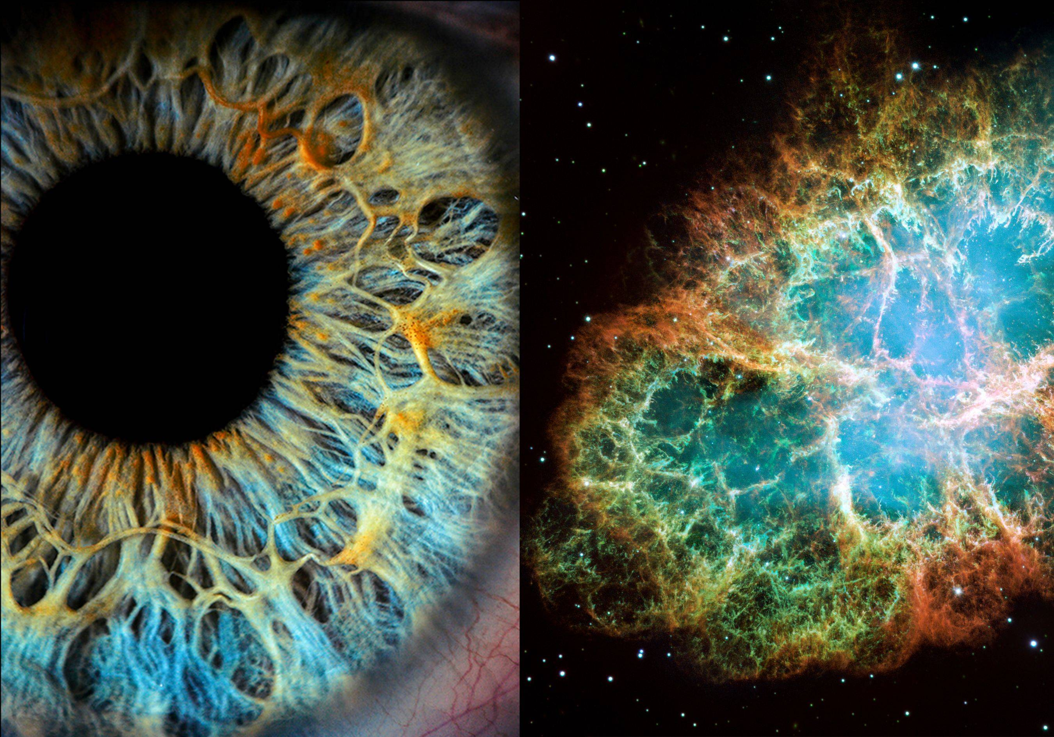

Slide 17
TRIANGLE of HEALING

Slide 18
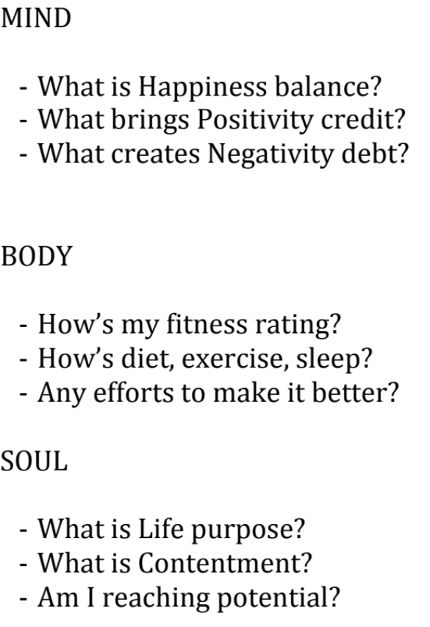
Mind, Body & Soul Map

Slide 19
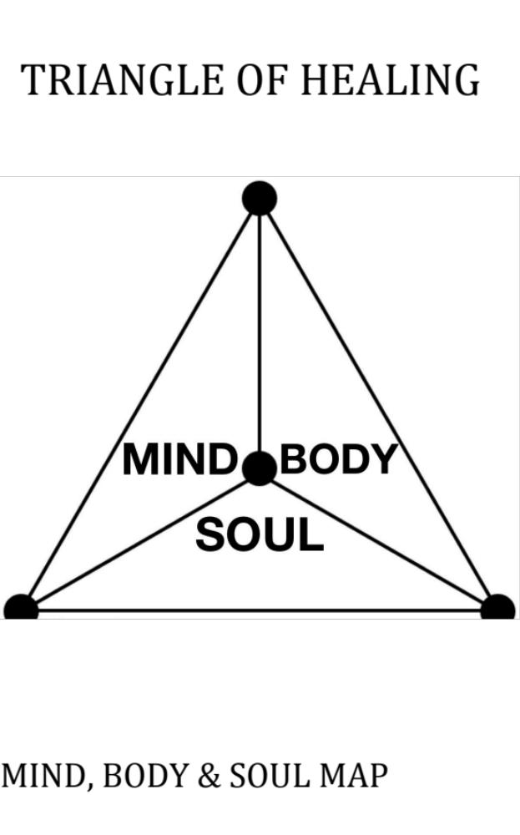

Slide 20
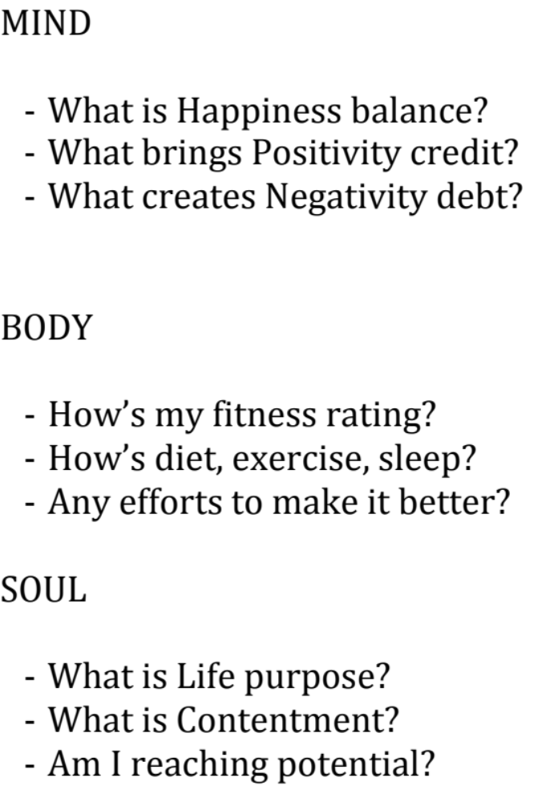

Slide 21
Healers;
-ProActive
-Healers heals World
-Cosmos heals Healers
You are The Healer.

Slide 22
